Slide 1
Lessons Learned from Scenarios Found during PHA of Startup, Shutdown and Online Maintenance
Stephen Bridges

Slide 2
Stephen Bridges Process Safety Engineer, Process Improvement Institute (PII)
BS Chemical Engineering (U.T. Knoxville)
10+ yrs experience, including 4 years Operations Management
PHA’s: Leading (7+ projects), Scribing (20+ projects/900+ hours)
Facilitated PHAs across many industries, including munitions handling, hazardous waste destruction, oil & gas refining, silicon, steel, TiO2, ClO2, polymer and pulp & paper
Plant experience included roles as PSM leader and trainer for PHA Leader software. Trained in all elements of PSM, with special focus on Incident Investigation/Root Cause Analysis, Human Error Prevention, MOC, PHA, and LOPA
USAF Veteran – Electronics & communication specialist
2

Slide 3
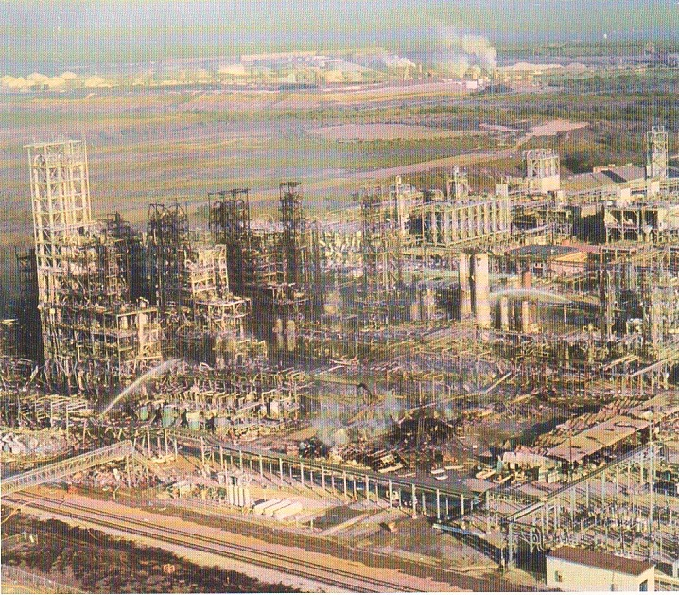
Discussion topics
When do most Major Process Safety accidents occur?
Approach for Fully Addressing Human Factors in Hazard Evaluations (PHAs)
Case studies of PHA of Procedures
3

Slide 4
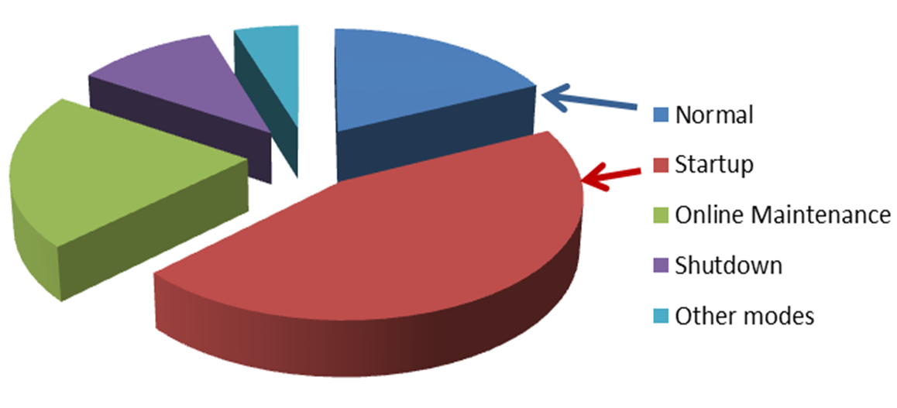
When do most Major Process Safety Accidents Occur?
4

Slide 5
The [Sad] State of Current PHAs
Instead of focusing on the most hazardous modes of operation, most PHAs focus on normal operations (e.g., HAZOP of equipment nodes). The majority (>80%) of PHAs/HAZOPs (new and old), do not analyze the non-routine modes of operations as recommended in Chapter 9.1, 3rd Ed, Guidelines for Hazard Evaluation Procedures, CCPS/AIChE
In some PHAs, the team discusses startup, shutdown, and online maintenance modes as “deviations” during equipment node-by-node discussions; however, this method only identfies 10% of the scenarios for non-routine modes of operation
If the hazard evaluation (e.g., PHA) does not find the scenarios, the organization will not know what safeguards are needed (or even if they’re vulnerable at all)
5

Slide 6
Approach for Fully Addressing Human Factors in Hazard Evaluations (PHAs)
6

Slide 7
4 key Steps for addressing human factors during phas
Step 1: Ensure education and experience of PHA/HAZOP Leader in human error prevention; competence in PHA of procedures
Step 2: Ensure that brainstorming of scenarios during PHA of all modes includes consideration of human error and even multiple human error as causes.
Step 3: Have the PHA team perform a hazard review of procedure steps to uncover potential human errors associated with startup, shutdown, and online maintenance modes. Company standard must require PHA of Procedures.
Step 4: Supplement the PHA/HAZOP of the individual scenarios with a checklist analysis of general human factor issues, to ensure all major categories were addressed (covering anything that slipped through the cracks)
7

Slide 8
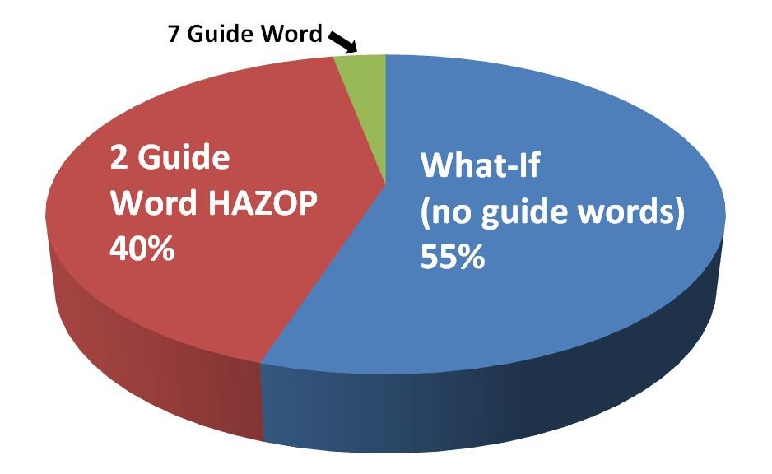
PHA of non-routine operating modes: Methodology usage
8

Slide 9
2-3 Guideword – HAZOP Method for Procedures
Guide Phrase | Meaning When Applied to a Step
Step is Missing from Procedure (optional) | A step or precaution is missing from the written procedure prior to this step
Step not performed | The specified intent of this step is not performed fully (includes the concept of “Part-of”)
Step performed wrong | The step is performed in an incorrect manner (the specifics of the error are left to the team to discuss). Includes all errors of commission concepts such as More, Less, Sequence Wrong, As Well As, and Other Than
*This approach is essentially the structured What-If that was used before the 7 GW HAZOP approach was developed in 1963; it turns out that it is sufficiently thorough for nearly all processes/procedures
9

Slide 10
What-If Method for Analyzing Procedures
What-if method for analyzing procedure-based modes of operations is free brainstorming without guide words
Read the procedure and answer the question: “What mistakes will lead to our consequences of interest?”
List these mistakes and then brainstorm the full consequences, causes, and existing safeguards
What-if brainstorming is not applied to each step of the procedure, but instead covers the entire task at one time
10

Slide 11
CASE STUDIEs: PHA of non-routine Operating Modes
11

Slide 12
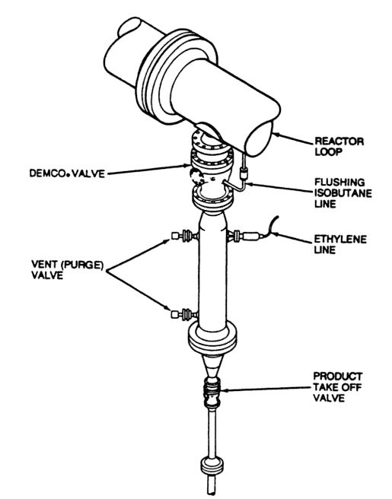
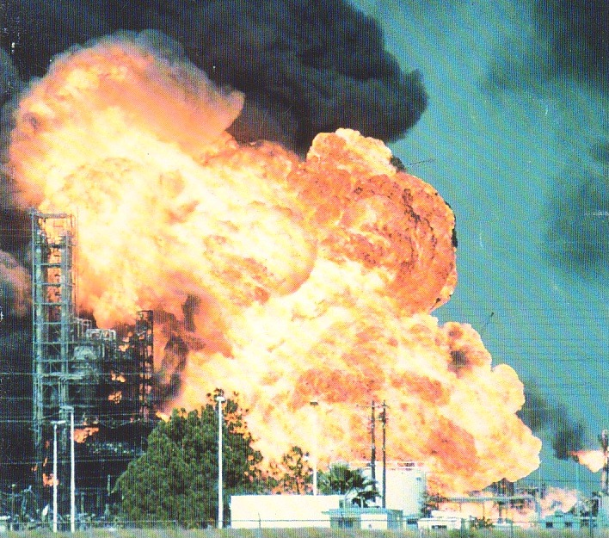
Case study 1 – rebuild of Phillips Polyethylene units
Pasadena TX, Oct. 24, 1989: 24 killed, 130 injured, $1.4 billion loss
Prior PHAs did not analyze “on-line” maintenance activity of removing a plugged settling pipe (a task performed every shift on each reactor)
12

Slide 13
Case study 1 – rebuild of Phillips Polyethylene units (Post-disaster)
ANALYSIS SETUP
1991-1992 PHA performed (by executive mandate) for first of the rebuilt polyethylene plants at the Pasadena, TX complex
Settlement Agreement (Phillips vs. USA): Ensure the PHA of the rebuilt units addresses hazards during All modes of operation
The PHA team always included two operators, and was lead by a process engineer with 15 years of experience, trained in human factors (Bill Bridges, PII)
PHA – INITIAL PHASE
PHA of continuous mode of operation
Approx. 250 nodes of equipment; from feed stock ➔ pellet handling
Used “parametric deviation” form of HAZOP (and some What-If)

Slide 14
Case study 1 – rebuild of Phillips Polyethylene units – non-routine modes
Step-by-step analysis of all startup, shutdown, and online maintenance procedures:
700 steps (which changed the state of the system) were reviewed
Used 7 Guide-Word HAZOP method (*2 Guide-Word analysis was not known to the team at this time/not yet proved as effective enough)
Example: For deviation: “operator skips a step”
Cause: "the operator doing this step miscommunicates with the operator who performed steps earlier in the day and went to the wrong reset panel/switch in the field"
So, the wrong switch was flipped & correct switch was not flipped

Slide 15
Case study 1 – rebuild Polyethylene units – PHA of non-routine modes
ENHANCED & NEW SAFEGUARDS SUGGESTED FROM ANALYSIS of NON-ROUTINE MODES OF OPERATION:
Some new safeguards lowered the likelihood of the error by addressing a human factor weakness
Added 15% more safety related instrumented interlocks (these would be called SIFs today), installed various new mechanical interlocks/linkages and larger relief valves for 7% of the PSVs
Some sections of the process were redesigned to lower the inherent risk, such as by adding error-proofing (Poka Yoke) features
15

Slide 16
Case study 2 – UNITED ETHYLENE (SABIC), JUBAIL, SAUDI ARABIA
Performed late 2018, ~4 weeks of meetings
1 week (5 days/25%) allocated to PHA of Procedures for analysis of Non-continuous/Non-normal Modes of Operation: Startup, Shutdown, Online Maintenance
PHA Team included Lead Operators, Field Operators, and was heavily supported by Maintenance (DCS, E&I, Mechanical) and PSM personnel.
Meetings held off-site, but plant personnel had network access, allowing them to quickly obtain PSI related documents, minimizing confusion and delay during the PHA (i.e., minimizing the Open Items)
16

Slide 17
Case study 2 – UNITED ETHYLENE (SABIC), JUBAIL, SAUDI ARABIA - METHODOLOGY
Procedures were prioritized into categories by severity of consequences (given a human error) and relative complexity of tasks
2 Guide Word step deviation was used for highest risk procedures, where each step discussed as potential deviation (more detailed analysis and scrutiny)
‘What if’ methodology used for medium risk procedure analysis, followed by ‘Fast What if’ for as many of the lowest risk procedures that time allowed.
17

Slide 18
Case study 2 – UNITED ETHYLENE (SABIC), JUBAIL, SAUDI ARABIA – PHA Summary
The PHA team identified many hazard during the meeting in both the normal mode HAZOP and the PHA of Procedures, listing 115 Safety Critical Recommendations
Of these Recommendations, 42 (or 36% of total) were identified during the PHA of Procedures
14 were in response to critical (high risk) consequences identified in the procedure analysis, requiring new or upgraded independent protection layers to bring the risk to acceptable levels.
The scenarios and related recommendations found during PHA of procedures accounted for 80% of risk reduction from the entire PHA, amounting to about $200 million USD in risk reduction.
18

Slide 19
Case study 2 – UNITED ETHYLENE (SABIC), JUBAIL, SAUDI ARABIA
Example:
During the procedure analysis for the acetylene reactors, it was discovered that there were no adequate safeguards against run-away reaction during start up, meaning the reactor shell could reasonably be expected to fail at some point due to human error during startup, which would likely cause a large explosion with the potential for multiple fatalities. The startup process required an extremely slow ramp-up in temperature (1°C per 5 minutes), and was controlled entirely by control room operators (by manually changing set points as they monitored for temperature spikes). In this case, the team recommended new logic and safety instrumented functions to protect against the catastrophic reactor failure and explosion.
19

Slide 20
Case study 3 – Olefin plant, Saudi Arabia
Performed in late 2019, meeting time of ~11 weeks
~3 weeks of PHA spent on procedures, or about ¼ total meeting time
Of the 282 safety related recommendations generated, 130 came from PHA of Procedures
It is estimated that of the total savings (cost avoidance), 70-80% were from scenarios identified in procedure analysis (valued at $300 Million USD)

Slide 21
Case study 3 – Olefin plant, Saudi Arabia
Example:
During the PHA review, it was found that a gas drier shell could fail if the cooling cycle’s expected temperature is not reached before bringing dried back to operating pressure. The risk of this human error based accident scenario was too high by several orders of magnitude. Therefore, the team recommended additional hardware or instrumentation safeguards to prevent pressurizing the dryer before the temperature is low enough (before the cooling cycle is completed) such as by installing a logic sequence that can't be bypassed, with a timer and temperature confirmation of shell/piping readiness for pressure, and count/duration of cooling volume.

Slide 22
Case study 4 – CHEMANOL, Saudi Arabia
In the summer of 2019 a PHA was performed for on methanol and formaldehyde units, meeting ~2 weeks.
Procedure analysis ~1/4 total meeting
An estimated 50% of total risk reduction originated in recommendations from PHA of Procedures

Slide 23
Case study 4 – CHEMANOL, Saudi Arabia
Example:
During the PHA of Procedures, it was determined that leaving a manual vent valve open following maintenance was a potential explosion hazard and environmental concern. The team recommended adding an IPL to ensure that the Catalytic Incinerator is lined up correctly and the vent line to atmosphere is closed, as a permissive for bringing the formaldehyde plant fully online. A captive key system was one option suggestion for this IPL, as it may provide the best option for protection, requiring a proper sequence of valves be opened and closed during the startup procedure.

Slide 24
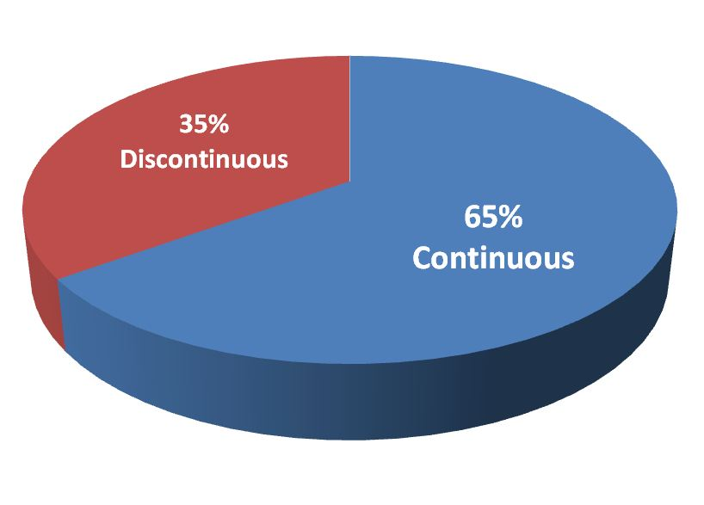
Investment justification for pha of non-routine mode
Detailed PHA of Procedures does not take much investment (no more than 25% added man hour costs for meeting) yet can save millions or even billions $$$
Chemical-related companies estimate the average return on investment at >1000 to 1, based on newly discovered accident scenarios that would likely occur over the process lifetime
A $50,000 investment can easily equate to $200,000,000 in risk reduction
80% of major accidents

Slide 25
Interrelationship of PSM Elements
Employee Participation
Leadership & Accountability
Employee Participation
Leadership & Accountability
Human Factors (HSI, communication, FFD, work env.)
SWPs
SWPs
MI/QA
SWPs
Training
PSSR
MI
Deficiency
SOPs
PSI
PSSR
MOC
SMPs
Engineering
Specifications
Revalidations
SWPs
Recommendations
Recommendations
Batch, SU, SD, ESD steps
PHAs
Incident
Investigations
Troubleshooting Guides
Revalidations
Consequences of Deviations/
Steps to Correct/Avoid & Operating Limits
Prioritized MI Activities
Contractors
ERP
Audits (& KPIs)

Slide 26
closing
Addressing human errors requires a PHA leader with experience in human factors and PHA of procedures (ideally with Operations background)
The approach of step-by-step HAZOP and/or What-If analysis has been proven over several decades
Frequency and consequences from human error can minimized with a well-designed strategy for analyzing risk of non-routine operating modes
The marginal increase in cost and dedicated time needed to properly analyze non-routine modes, specifically by performing PHA of Procedures, is trivial compared to the opportunity costs incurred in safety incidents. The majority of unprotected Major Process Safety Accidents can be prevented if industry closes this gap in their PHAs
26

Slide 27
Questions or Comments?
Stephen Bridges
sbridges@piii.com
William Bridges
wbridges@piii.com
27

